Slide 1


Genetics and Genomic Innovation: Pharmacogenomics
Kari Bernhardt, Krista Egan, & Karlee Litchfield
University of Mary
NUR 903: DNP Project & Nursing Scholarship III
Dr. Jenna Herman
September 25, 2022

Slide 2
Pharmacogenomics Overview
Field of precision medicine
Tailoring medical treatment through DNA
“one size fits all” does not work for everyone
Adverse drug reactions are a significant cause of hospitalizations and death
Researchers are learning how gene variants affect the body’s response to medication
Future potential to treat a wide range of health problems
(CDC, 2022; NIH, 2022)
Notes:
Pharmacogenomics is an important example of the field of precision medicine, which aims to tailor medical treatment to each person or to a group of people. Pharmacogenomics looks at how DNA affects the way an individual’s body respond to drugs. (CDC, 2022)
Many drugs that are currently available are “one size fits all” but they don’t work the same way for everyone. Adverse drug reactions are a significant cause of hospitalizations and death. Researchers are learning how variants in genes affect the body’s response to medications. These genetic difference will be used to predict whether a medication will be effective for a particular person and which dose will help prevent adverse drug reactions (NIH, 2022).
The field of pharmacogenomics is growing, and new approaches are under study in clinical trials. In the future, pharmacogenomics will be used to develop tailored drugs to treat a wide range of health problems, including cardiovascular disease, Alzheimer disease, cancer, and asthma (NIH, 2022)

Slide 3

Broad Outcome
Following the presentation, learners will be able to verbalize the role that pharmacogenomics plays in prescribing medications.

Slide 4
Behavioral Objectives
Following the 10-minute teaching session, learners will be able to:
Recognize how pharmacogenetics can help decrease adverse drug reactions
Identify at least two medication classifications that are impacted by pharmacogenetics
Understand how clinicians make specific prescribing decisions for patient care when genetic information is available

Slide 5
Goals of Pharmacogenomics
Maximize drug efficacy
1
Minimize drug toxicity
2
Predict patients who will respond to intervention
3
Aid in new drug development
4
(Roden et al., 2011; Rollinson et al., 2022)
Notes:
Pharmacogenomics involves the investigation of the effects of genetic variation and the differences in our genome on drug response. Pharmacogenomics aims to improve the safety and effectiveness of drug treatment by using genetic information to inform prescription decision making, similarly to how renal function is taken into account when prescribing drugs that are eliminated by the kidneys.
The implementation of pharmacogenomics can maximize drug efficacy, minimize drug toxicity, predict patients who will respond to interventions, and aid in new drug development

Slide 6
History of Pharmacogenetics
‘Pharmacogenetics’ coined in 1959
Current prescribing approaches bases on factors like age, weight, and co-morbidities
Beneficial response to drug can be anywhere between 25%-80%
6% of hospital admissions related to ADR
Pharmacogenomics aims to offer clinical decision support
Improves benefit-risk profile of prescribing medications
(Rollinson et al, 2017)
Notes:
The term pharmacogenetics was coined in 1959 by German geneticist Friedrich Vogel and relates to the study of inherited genetic differences in drug metabolic pathways that can affect individual responses to drugs, both in terms of therapeutic effect as well as adverse effects. However, the concept that innate factors can affect drug response dates back as far as Pythagoras[. Pharmacogenomics is often used interchangeably with pharmacogenetics, and was first used in 1997
Current prescribing approaches include a degree of individual tailoring based on factors such as age, weight, biochemical markers and co-morbidities. However, despite these considerations some patients do not respond in the expected manner.
The number of patients who respond beneficially to a given drug can be anything between 25% and 80%. Furthermore, around 6% of hospital admissions are related to an adverse drug reaction (ADR) , and drug tolerability issues are associated with poor medication adherence. Pharmacogenomics aims to offer clinical decision support to improve the benefit–risk profile of prescribed medications.

Slide 7

Genetics of Drug Response
Estimated 97% of individuals carry at least one variant in genes that influences drug response
May impact absorption, distribution, metabolism, and excretion
May influence drug’s on-target and off-target
Majority of ADRS are type A reactions
Identification of mutations can be used to design new drugs
Lack of understanding major barrier implementation
(Rollinson et al, 2017)
Notes:
It is estimated that more than 97% of people carry at least one variant in a gene that can influence drug response by disturbing either the pharmacokinetics or the pharmacodynamics of a drug
For example, some genetic variants impact on drug pharmacokinetics by affecting genes involved in drug ADME: absorption, distribution, metabolism and excretion, including drug-metabolising enzymes (e.g. cytochrome P450 isoforms, CYPs) and drug transporters. Genetic variants can also influence both a drug’s on-target and off-target pharmacodynamic effects.
The majority of ADRs that lead to hospital admission are type A reactions (over 80%). These are predictable from knowledge of a drug’s pharmacology and usually result from excessive drug activity through increased systemic exposure and/or increased sensitivity of the target site to the drug
The identification of mutations is also being used to design new drugs that must be used in patients with that mutation.
Recent decades have seen multiple advances within the field of genomics. there is a lack of understanding of the topic and its application among healthcare professionals.

Slide 8
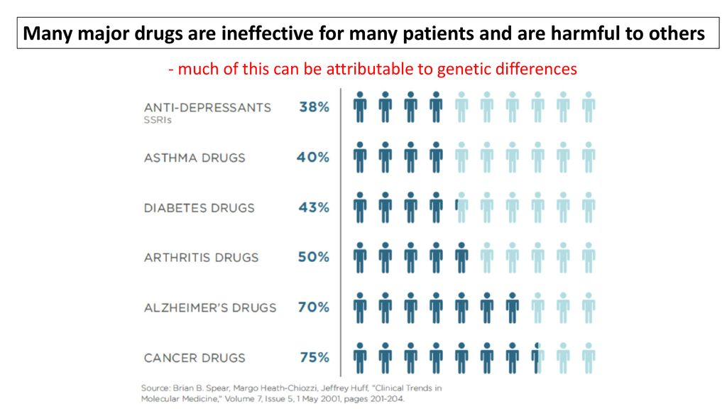
(Roden et al., 2011)
Notes:
This can be attributable to genetic differences

Slide 9

GeneSight Psychotropic Test
Pharmacogenomic test that analyzes clinically important genetic variations which may impact how patients metabolize and respond to medications used to treat depression, anxiety, ADHD, and other psychiatric conditions
Benefits: helps avoid multiple medication trials, aids in the prediction and prevention of adverse effects and drug-drug interactions
Cost: $0 with Medicare or Medicaid; $330 or less with private insurance or uninsured
Notes:
The GeneSight Psychotropic test is a pharmacogenomic test that analyzes clinically important genetic variations which may impact how patients metabolize and respond to certain medications used to treat depression, anxiety, ADHD, and other psychiatric conditions. The use of GeneSight testing may help providers avoid multiple medication trials by providing information about which medications may require dose adjustments, be less likely to work, or have an increased risk of side effects based on the patient's genetic information. The clinical validity, clinical utility and economic utility of the GeneSight Psychotropic test have been evaluated in multiple peer-reviewed publications and currently, it’s the only neuropsychiatric pharmacogenetic test backed by extensive research. The GeneSight Psychotropic test must be ordered by a provider. The cheek swab can be collected in the clinicians office or the patient can do it at home and send it in with the patient home collection kit (Altar et al., 2015; GeneSight, n.d.).

Slide 10
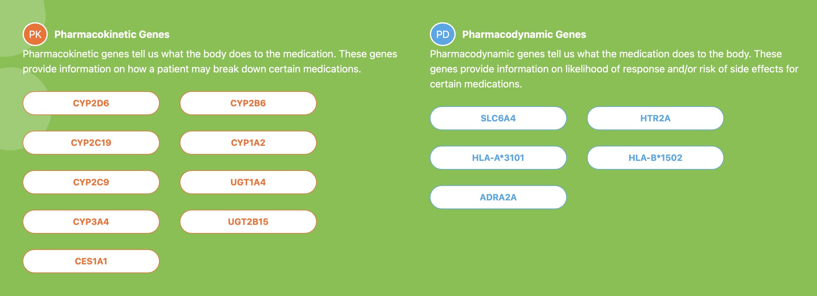
Genes Included in the GeneSight Psychotropic Test
(GeneSight, n.d.)

Slide 11
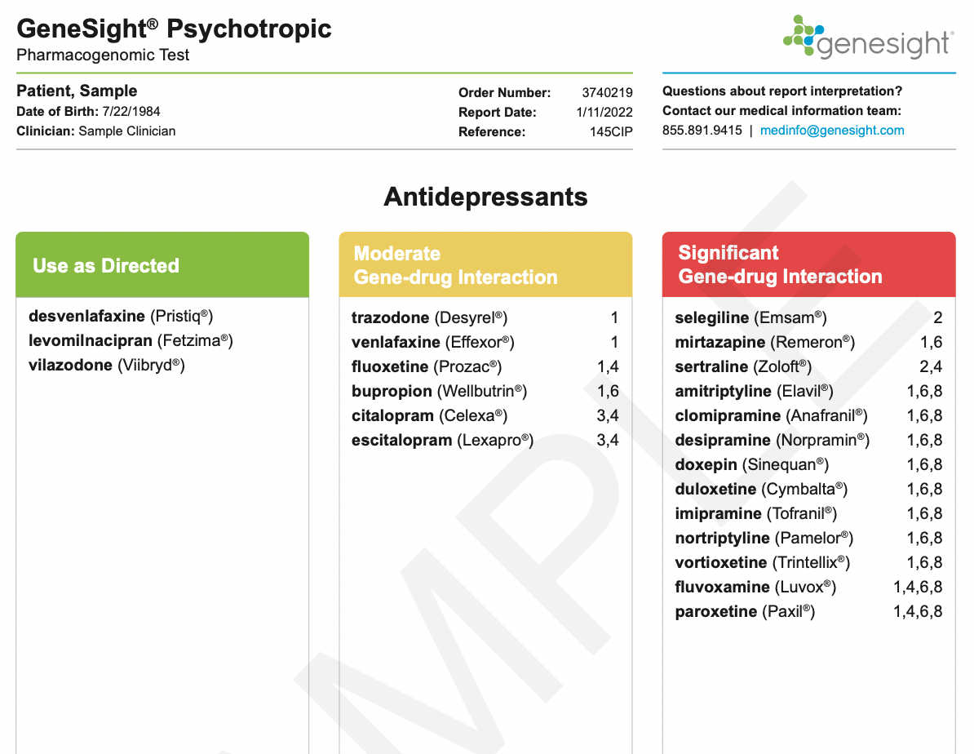
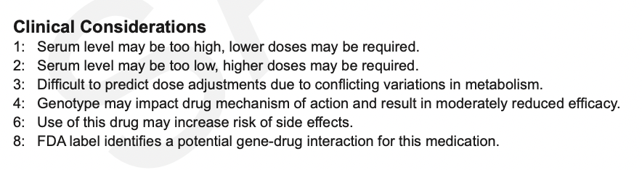
GeneSight Psychotropic Test Sample Report
(GeneSight, n.d.)

Slide 12

Application to Practice
Personalized medicine
Utilization of pharmacogenomics in clinical decision making
Impact of pharmacogenomics on personalized medicine:
Cancer
Neurodegenerative diseases
Thrombosis
Cardiovascular diseases
Anesthesia
Type 2 Diabetes
Psychiatry
Hypertension
(Singh, 2019)
Notes:
In previous decades, all patients with a particular disease received treatment with the same drug. However, now that personalized medicine has grown in popularity, pharmacologic treatment has become more individualized. As mentioned in the previous slides, genetic variants associated with pharmacokinetics and pharmacodynamics of a drug determine the outcome or efficacy of treatment. Thus, genomic information has the ability to significantly impact the medication dosage and response of treatment.
As providers, we have the ability to utilize pharmacogenomics as a part of our clinical decision making. Pharmacogenomics has been applied to personalized medicine in a variety of topic areas, including cancer, neurodegenerative diseases, thrombosis, cardiovascular diseases, anesthesia, type 2 diabetes, psychiatry, and hypertension.

Slide 13
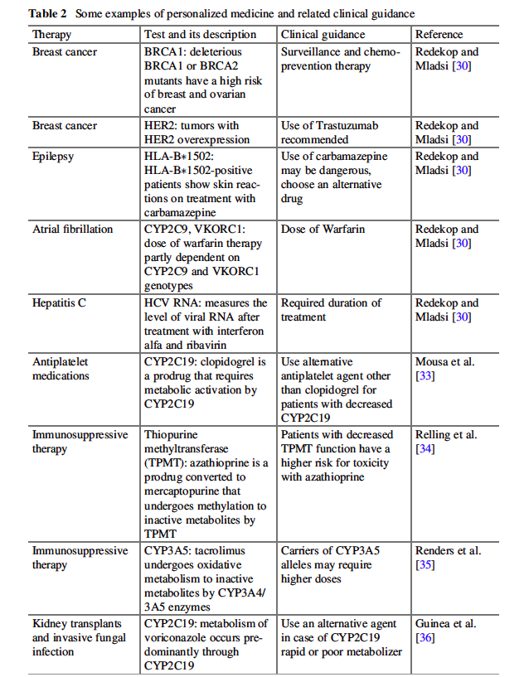
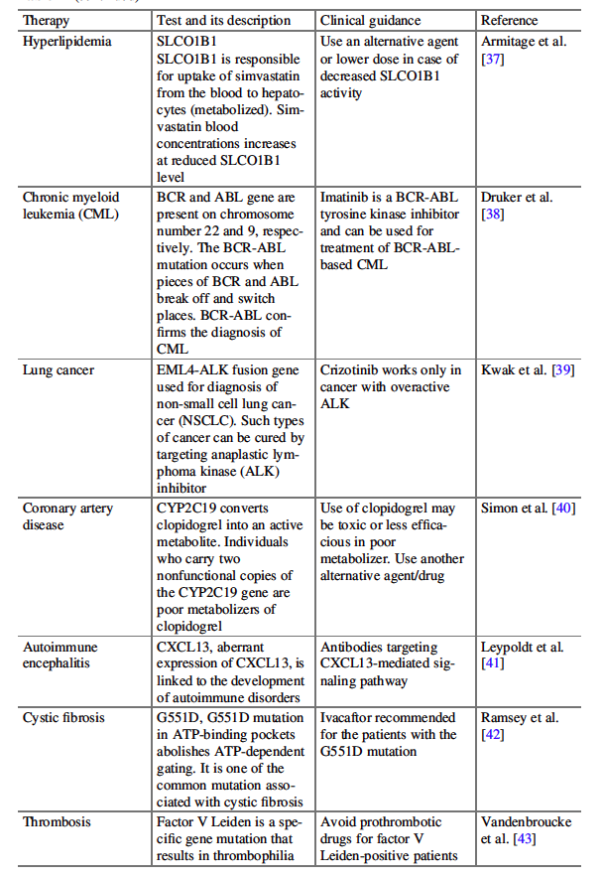
(Singh, 2019)

Slide 14
Challenges to Widespread Use of Genotyping
Limitations in the design of published pharmacogenetic studies
Regulatory and ethical concerns
Lack of cost effectiveness analyses
Limitations in the number of available tests and guidelines for implementation
Lack of education
Potential delay in therapy
(Tantisira & Weiss, 2022)
Notes:
While the benefits of pharmacogenetic testing are well-established, implementation into clinical practice has been slow. There are several reasons for the lack of implementation, including limitations in the design of published pharmacogenetic studies, regulatory and ethical concerns, lack of cost effectiveness analyses, limitations in the number of available pharmacogenetic tests and lack of guidance for test implementation, a lack of education on the benefits of pharmacogenetic tests and lack of guidelines for implementation, and a potential delay in therapy while awaiting results of genotyping.

Slide 15
Potential Benefits of Pharmacogenomics-based Therapies
Reduction in trial-and-error prescription
Improved drug safety
Reduction in time and cost of clinical trial
(Singh, 2019)

Slide 16
Future Applications
Discovery of more potential biomarkers
Framing regulations for genetic privacy and confidentiality
Equity of access to personalized medicine
Standardization of genetic testing and documentation
Regulation for private genetic testing firms
Better awareness about personalized medicine
(Singh, 2019)

Slide 17
Check-In Question #1
Which of the following is not a goal of pharmacogenomics?
Minimize drug toxicity
Aid in new drug development
Maximize drug efficacy
Eliminate the use of prescription medications
Predict patients who will respond to intervention

Slide 18
Check-In Question #1
Which of the following is not a goal of pharmacogenomics?
Minimize drug toxicity
Aid in new drug development
Maximize drug efficacy
Eliminate the use of prescription medications
Predict patients who will respond to intervention
(Roden et al., 2011; Rollinson et al., 2022)

Slide 19
Check-In Question #2
What is the difference between pharmacokinetic genes and pharmacodynamic genes?

Slide 20
Check-In Question #2
What is the difference between pharmacokinetic genes and pharmacodynamic genes?
Pharmacokinetic genes: tell us what the body does to the medication
Pharmacodynamic genes: tell us what the medication does to the body
(GeneSight, n.d.)

Slide 21

Discussion Questions
Share an example of a time when you utilized pharmacogenomics in your practice as an RN or NP student. What impact did it have on patient care/patient outcomes?
How might you incorporate pharmacogenomics into your own practice as an NP?
Should patients have access to pharmacogenomic testing without a providers’ orders? Why or why not?
What ethical factors should be considered when discussing the topic of pharmacogenomics? Explain.

Slide 22
Summary
Pharmacogenomics is an evolving area of healthcare innovation
Focuses on how DNA affects an individual’s response to a drug
Goals of pharmacogenomics
GeneSight is an example of a pharmacogenetic test utilized in clinical practice today
Pharmacogenomic testing is an important aspect of personalized medicine
Notes:
Pharmacogenomics is an evolving area of healthcare innovation focused on how DNA affects an individual’s response to a drug.
The goals of pharmacogenomics are to maximize drug efficacy, minimize drug toxicity, predict patients who will respond to intervention, and aid in new drug development.
GeneSight is one example of a pharmacogenomic test utilized in clinical practice today. This test analyzes clinically important genetic variations which may impact how patients metabolize and respond to certain medications used to treat depression, anxiety, ADHD, and other psychiatric conditions.
In previous decades, all patients were given the same treatment for a particular disease. However, with the advent of personalized medicine, this way of thinking is no longer sufficient. Pharmacogenomics allows clinicians to determine the most appropriate treatment for a patient based on their own individual genetic makeup. While the benefits of pharmacogenomic testing are clear, the application into clinical practice has been slow. As NPs, we can help bridge this gap and integrate this knowledge into practice.

Slide 23
References
Altar, C. A., Carhart, J., Allen, J. D., Hall-Flavin, D., Winner, J., & Dechairo, B. (2015). Clinical utility of combinatorial pharmacogenomics-guided antidepressant therapy: Evidence from three clinical studies. Molecular Neuropsychiatry, 1(3), 145–155. https://doi.org/10.1159/000430915
Centers for Disease Control and Prevention. (2022, September 15). Pharmacogenomics: What does it mean for your health? https://www.cdc.gov/genomics/disease/pharma.htm
GeneSight. (n.d.). The GeneSight Psychotropic test. https://genesight.com/product/
National Institute of Health. (2022, March 22). What is pharmacogenomics?: Medlineplus genetics. National Library of Medicine. https://medlineplus.gov/genetics/understanding/genomicresearch/pharmacogenomics/
Roden, D. M., Wilke, R. A., Kroemer, H. K., & Stein, C. (2011). Pharmacogenomics. Circulation, 123(15), 1661–1670. https://doi.org/10.1161/circulationaha.109.914820
Rollinson, V., Turner, R. M., & Pirmohamed, M. (2017, October 11). Pharmacogenomics: An overview. The Pharmaceutical Journal. https://pharmaceutical-journal.com/article/ld/pharmacogenomics-an-overview
Singh, D. B. (2019). The impact of pharmacogenomics in personalized medicine. Advances in Biochemical Engineering/Biotechnology, 171, 369-394. https://doi.org/10.1007/10_2019_110
Tantisira, K., & Weiss, S. T. (2022). Overview of pharmacogenomics. UpToDate. Retrieved September 24, 2022, from https://www.uptodate.com/contents/overview-of-pharmacogenomics?search=pharmacogenetic%20testing&source=search_result&selectedTitle=1~51&usage_type=default&display_rank=1#H3654033

